Slide 1

MICRON – HF WASTEWATER TREAMENT
SIMULATION & BENCH TESTING – Dec 2021
Siva Kumar Kota/Chun Yew
Hiep Le/Sankar
Part 3

Slide 2
Micron HFW Treatment -Next Steps and completion date
Sl.No. | Action Items | To be completed by | Remarks
1 | Perform projection to check the criticality of NF in this configuration If projection is good, will NF be a necessary unit operations here. What will be the benefits of incorporating NF in the design needs to be validated. | End/1st week of Dec | Will run few more simulations to validate the requirements
2 | The NaOH dosing for raising permeate Ph NaOH dosing requirement Final TDS | End/1st week of Dec | Will run few more simulations to validate the requirements
3 | Evaluate the effectiveness of Ca(OH)2 dosing by lab test Reaction rate with Ca(OH)2 Will increase of HRT help the completeness of reaction CaF2% in sludge to be validated for different water samples Settling velocity to be noted | End/1st week of Dec | Lab study
4 | As the projection data does not show on the TOC/IPA content in relevant streams, data to be generated based on some lab test or other projections | End/1st week of Dec | Lab study
5 | Na is coming into the streams due to ion balancing. Therefore, true presence of cations needs to be validated so that possible other contaminants issues can be identified. Clarified water characteristics RO permeate water characteristics | End/1st week of Dec | Simulations and lab study
6 | As neutralization with H2SO4 needs to take place for the clarified water, possibilities of any precipitation in the downstream to be verified | End/1st week of Dec | Simulations and lab study
7 | What will be the retrofits required if this system to be used for CMP waste-CMP WW Characteristics will be given later. | End/1st week of Dec | TBD
Notes:
200 micro siemens/cm
Solids – silica, abrasive,
No chemicals
ADD SLIDES for synthetic water

Slide 3
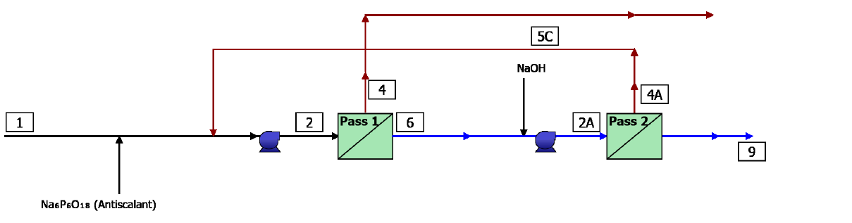
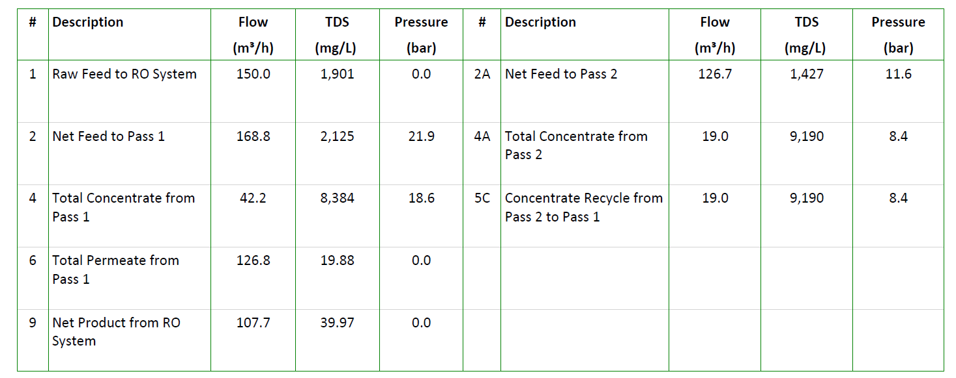
Action item 1 – Feasibility of SWRO +BWRO With 800 ppm of F

Slide 4
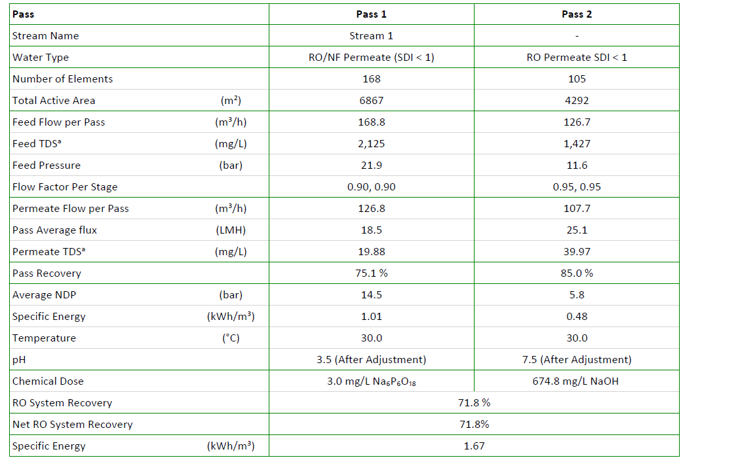
Action item 1 – Feasibility of SWRO +BWRO With 800 ppm of F

Slide 5
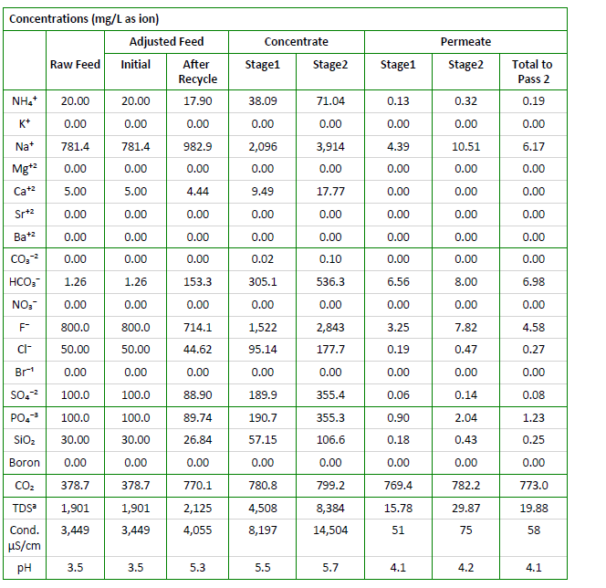
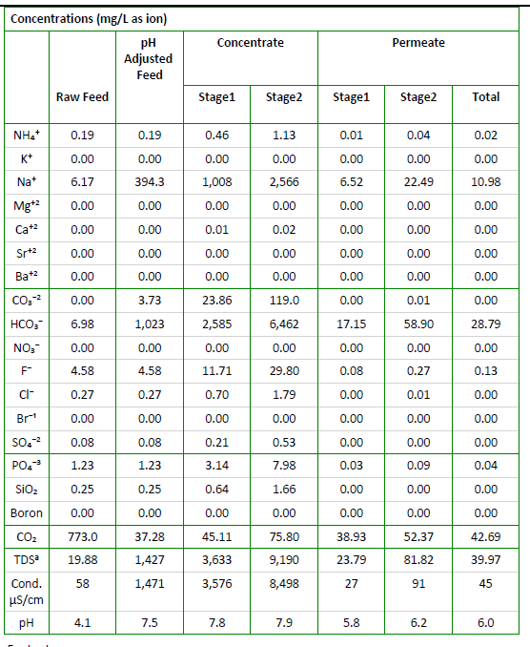
Action item 1 – Feasibility of SWRO +BWRO With 800 ppm of F
SWRO
BWRO

Slide 6
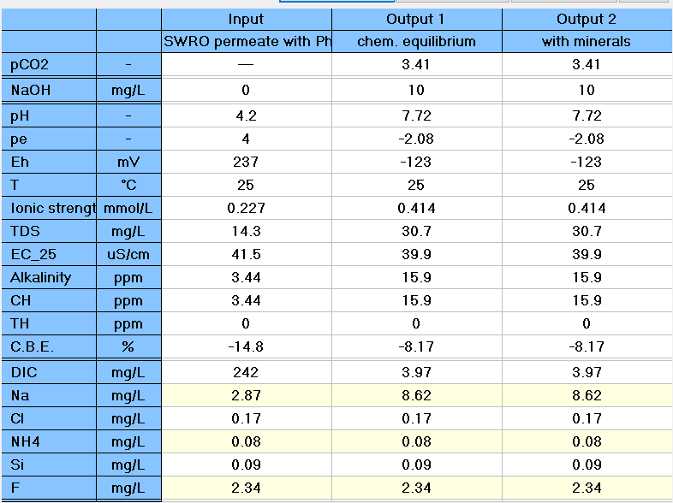
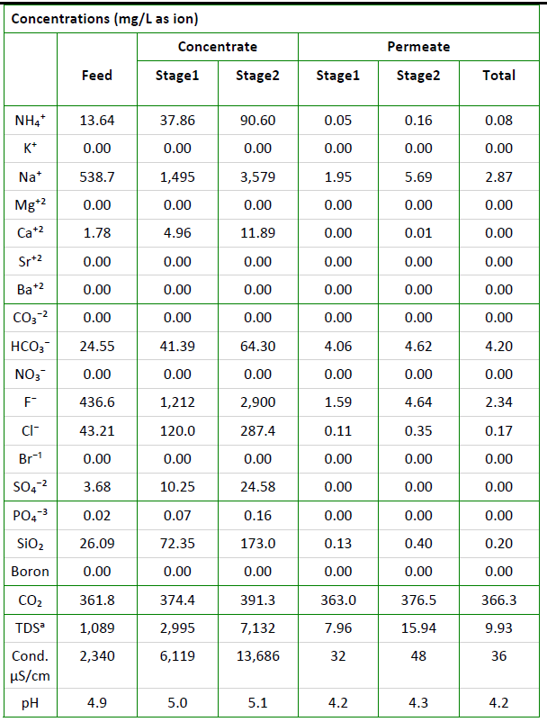
Action item 2: Permeate Ph adjustments
SWRO
pH adjustment

Slide 7
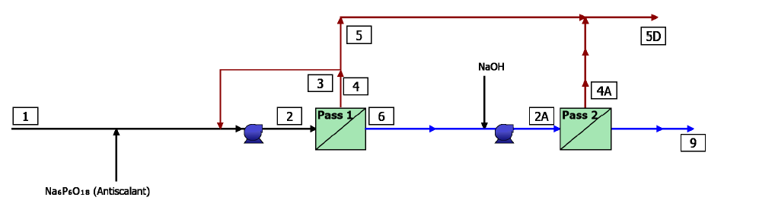
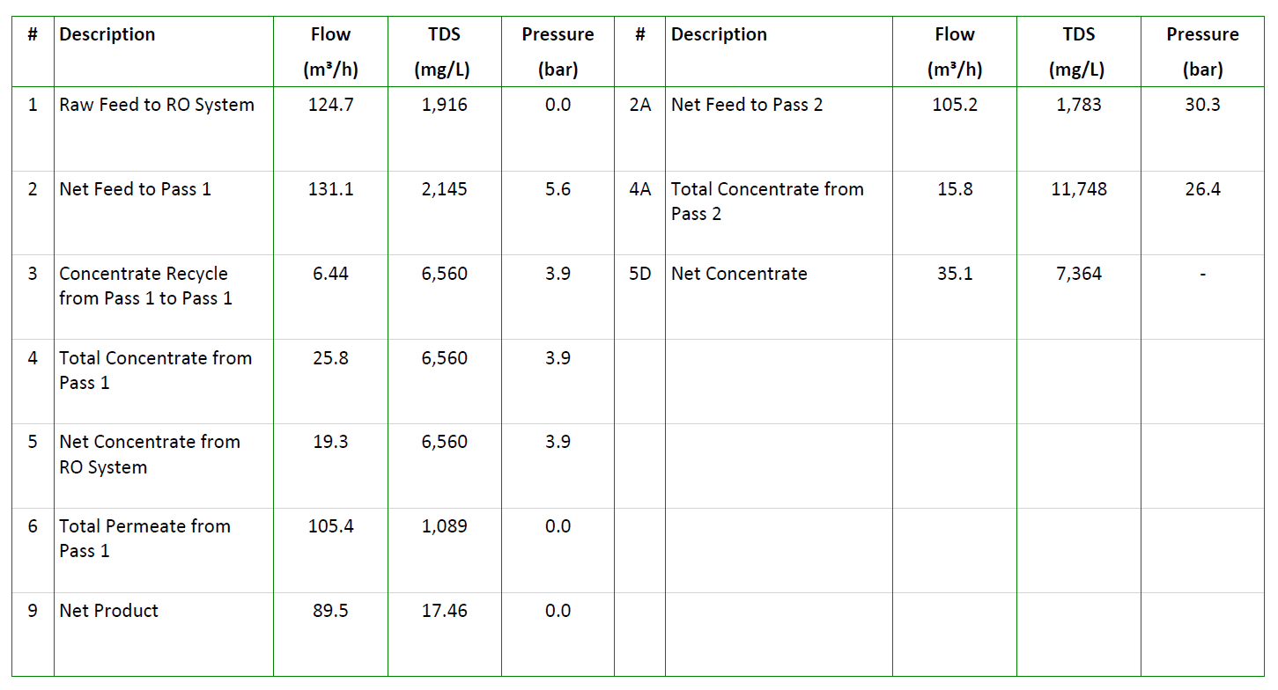
Action item 2: Option 6 – NF270 + SWRO With 800 ppm of F

Slide 8
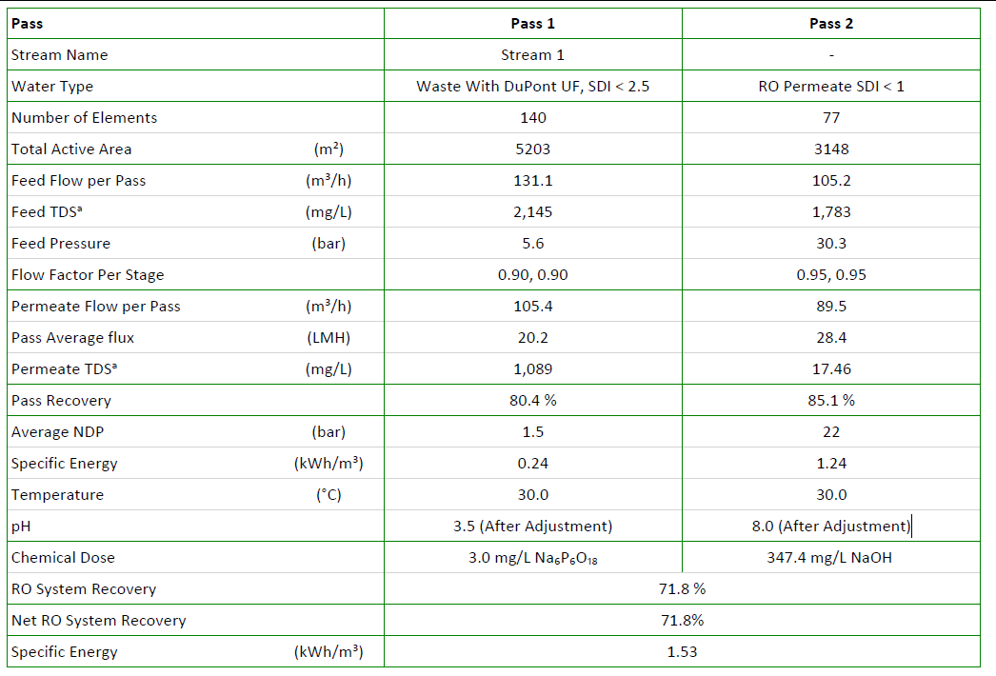
Action item 2: Option 6 – NF270 + SWRO With 800 ppm of F

Slide 9
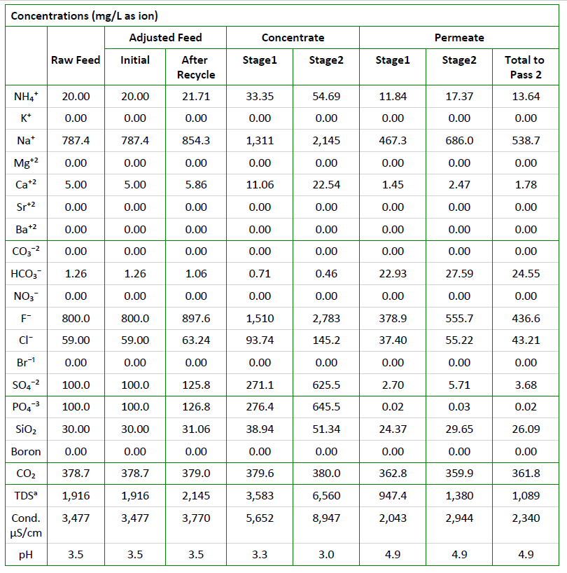
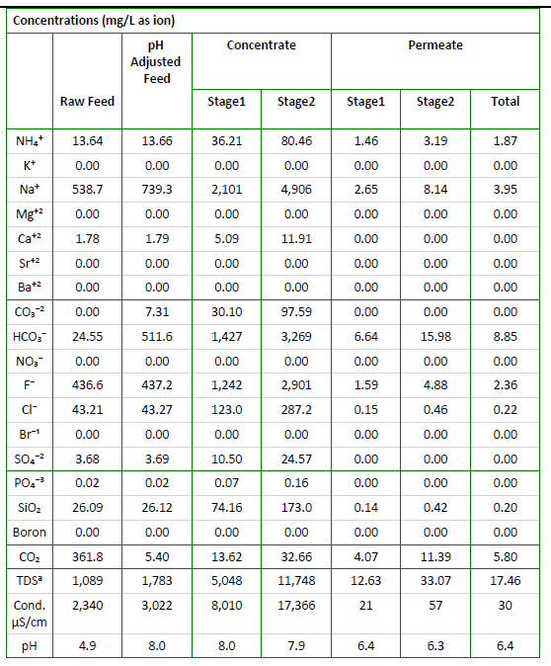
Action item 2: Option 6 – NF270+SWRO WITH 800 PPM of F
NF270
SWRO

Slide 10
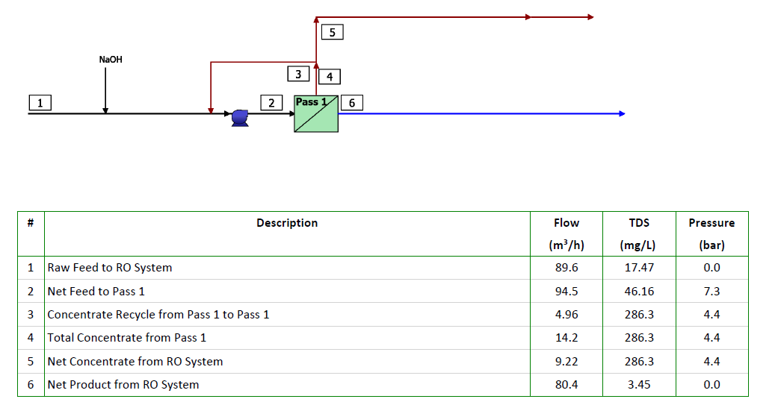
Action item 2: Option 6 – polishing BWRO to meet NEWater
Notes:
Cooling water spec
Ammonia<5ppm
Fluoride<2 ppm

Slide 11
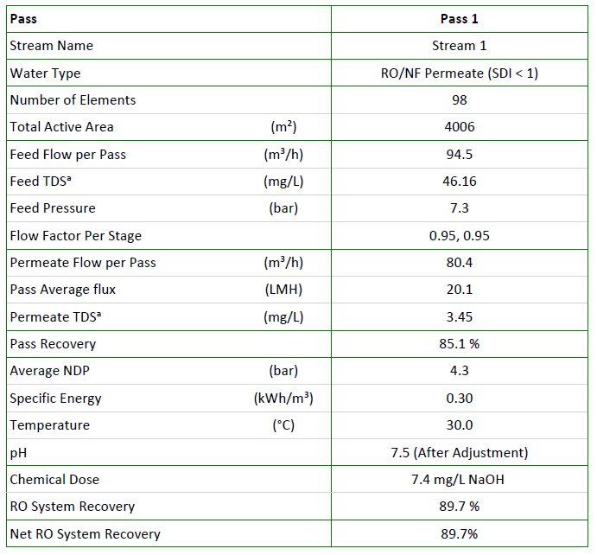
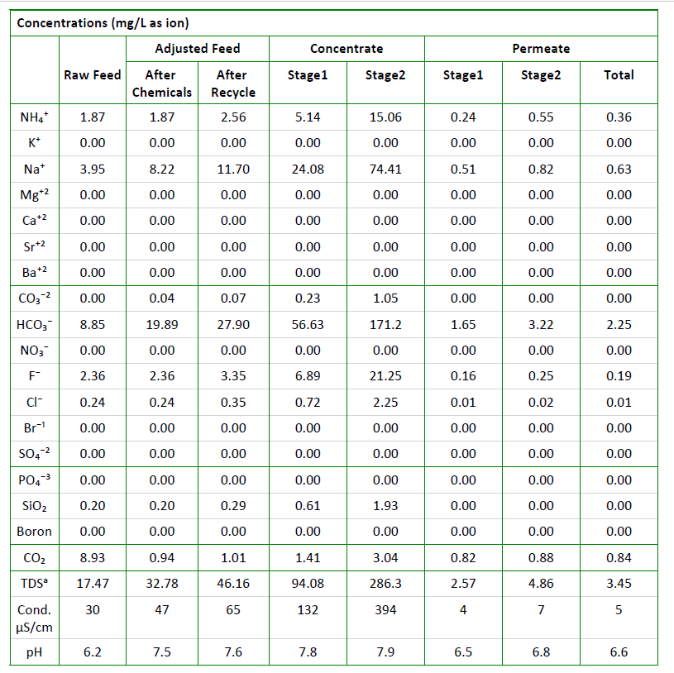
Action item 2: Option 6 – polishing BWRO to meet NEWater
Notes:
Cooling water spec
Ammonia<5ppm
Fluoride<2 ppm

Slide 12

Action item2: Option 6a–combined reject chemical precipitation

Slide 13
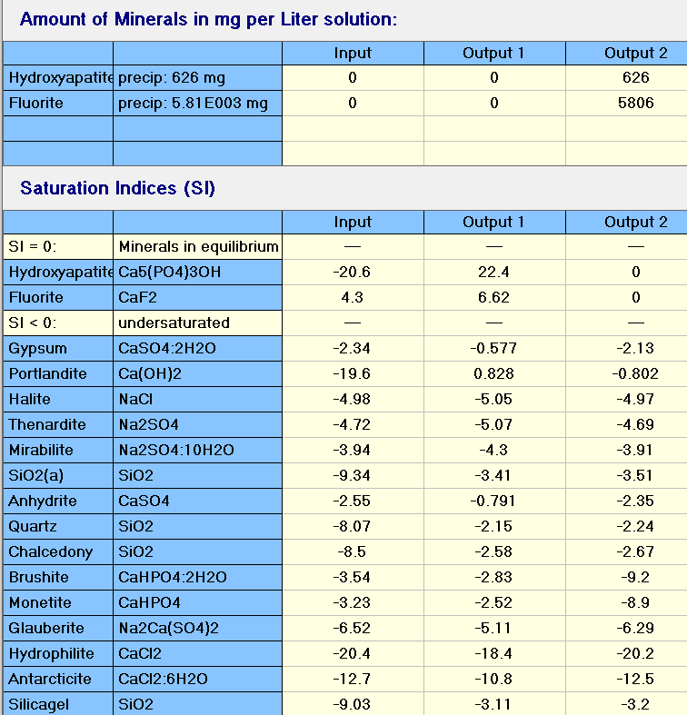
Action item 2: Option 6a–combined chemical precipitation –CaF2 sludge
>80% of CaF2 sludge

Slide 14
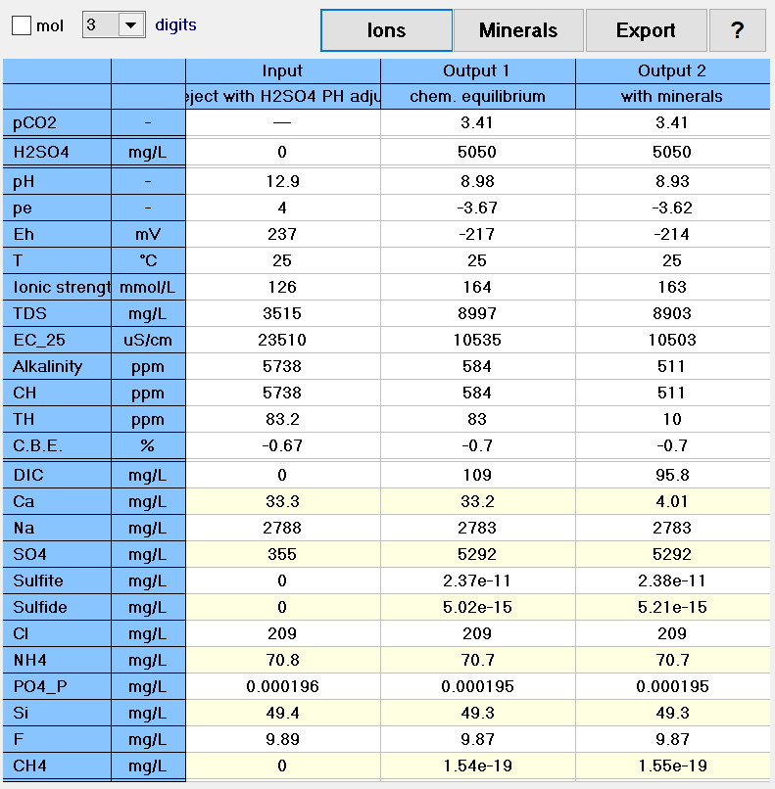
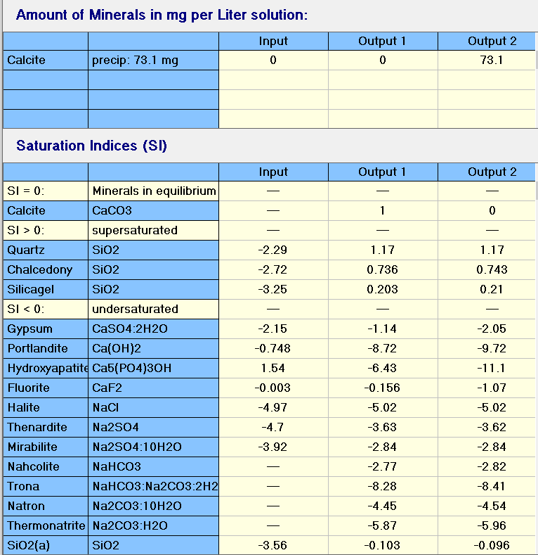
Action item6: supernatant pH adjustment using H2SO4

Slide 15
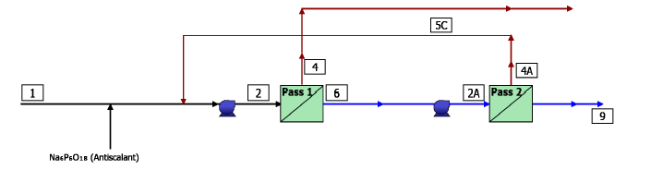
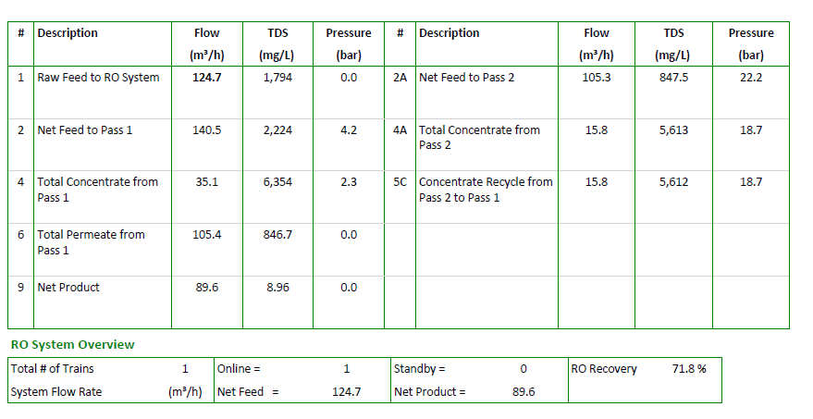
Additional Action item: Feasibility of NF270 + SWRO With 800 ppm of F, 500 ppm of PO4 and 300 ppm of Sulphates

Slide 16
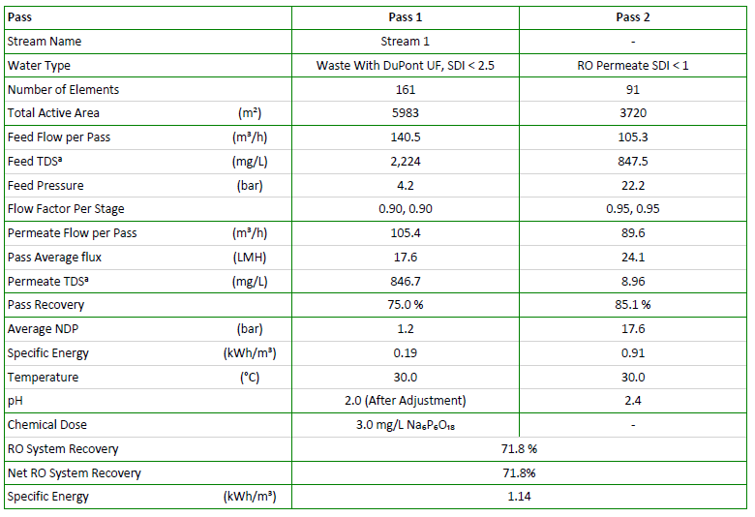
Additional Action item: Feasibility of NF270 + SWRO With 800 ppm of F, 500 ppm of PO4 and 300 ppm of Sulphates

Slide 17
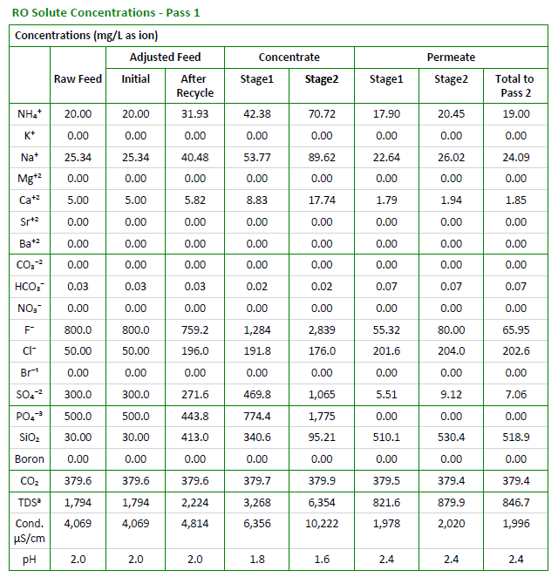
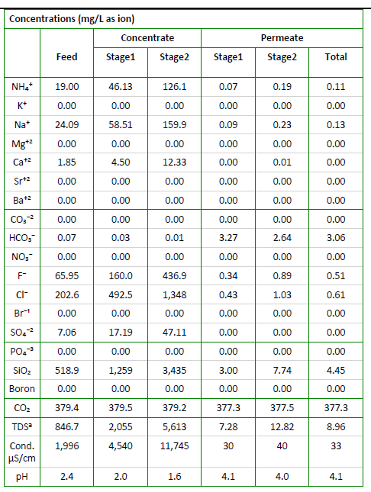
Additional Action item: Feasibility of NF270 + SWRO With 800 ppm of F, 500 ppm of PO4 and 300 ppm of Sulphates
NF 270
SWRO

Slide 18
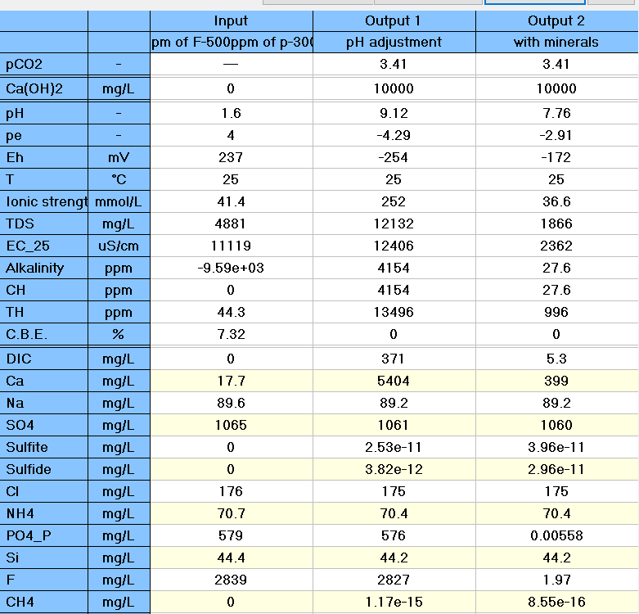
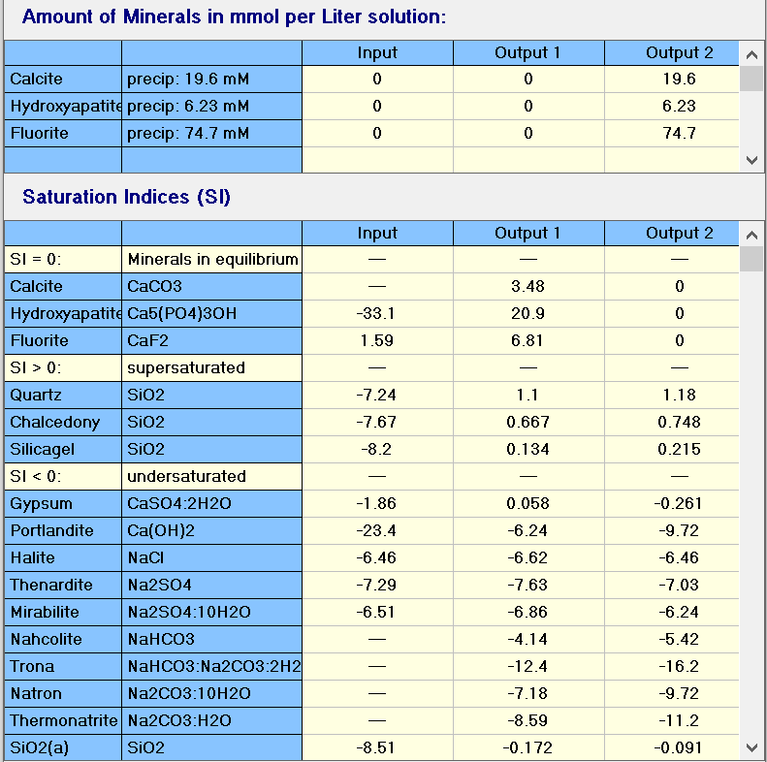
Additional Action item: Combined reject chemical precipitation

